Slide 2
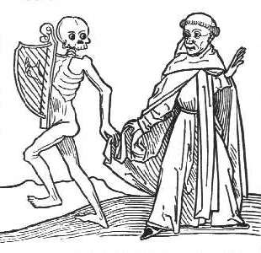
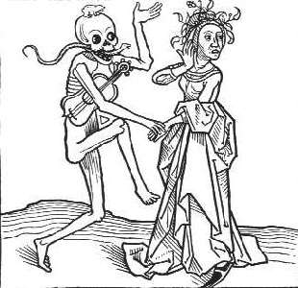
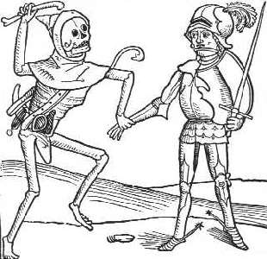
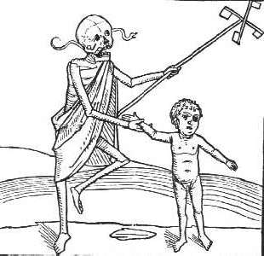
What is this artist suggesting about the Black death? Write down three key points you learn from these photos
STARTER
INFERANCE OF THESE SOURCES
10 MIN
SILENCE

Slide 3
Learning objective To investigate the understanding of the Black Death in the Middle Ages
ACTIVITY FIVE
SOURCE INVESTIGATION
ALL students will be able to identify ideas about causes of the Black Death, treatments and responses to the Black Death. [D-C]
MOST students will be able to explain ideas about the causes of the Black Death, the treatments used and various responses to it.[B]
SOME students will ALSO be able to also reach supported conclusions how successful people in the Middle Ages were at responding to the Black Death. [A-A*]
Responding to the Black Death
Working in pairs categorise the sources into four areas
Symptoms of the Black Death
What was believed to be the causes of the Black Death?
Treatments – what was used and why?
Responses to the Black Death – how did different groups respond and why?

Slide 4
Learning objective To investigate the understanding of the Black Death in the Middle Ages
ACTIVITY SIX
FILL IN TABLE
ALL students will be able to identify ideas about causes of the Black Death, treatments and responses to the Black Death. [D-C]
MOST students will be able to explain ideas about the causes of the Black Death, the treatments used and various responses to it.[B]
SOME students will ALSO be able to also reach supported conclusions how successful people in the Middle Ages were at responding to the Black Death. [A-A*]
Symptoms | Causes | Treatments | Responses
Swelling in the armpits and groin | Source K suggests it may have been the positioning of the planets | Source B suggests taking a live frog and putting its belly on the plague sore. The frog will swell and burst | Source E suggests ordinary people were getting drunk because they thought they were going to die
30 MIN

Slide 5
Learning objective To investigate the understanding of the Black Death in the Middle Ages
PLENERY
ALL students will be able to identify ideas about causes of the Black Death, treatments and responses to the Black Death. [D-C]
MOST students will be able to explain ideas about the causes of the Black Death, the treatments used and various responses to it.[B]
SOME students will ALSO be able to also reach supported conclusions how successful people in the Middle Ages were at responding to the Black Death. [A-A*]
Symptoms?
Causes of the Black Death?
Treatments?
Responses?

