Slide 1
Friday 13th February 2015
Victorian Britain and Crime
Lesson objective:
To be able to understand how children in Victorian Britain would be punished for crimes.
ALL students will be able to DESCRIBE how children were punished in Victorian Britain.
MOST students will able to EXPLAIN whether the Victorian punishments were fair.
SOME students will be able to INVESTIGATE the meanings of key words from this period.
Key question: Do we think their punishment was fair?

Slide 2
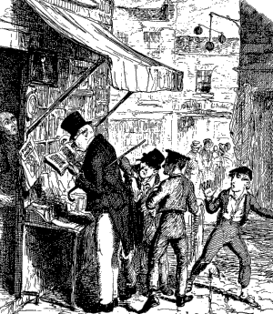
STARTER
What is happening in this source?
1 MIN
fill in boxes
1 MIN
Discuss your list with a partner
Extension:
What are their ages?
How would they be punished?
2 min

Slide 3
STARTER
Crowded city area
Rich/wealthy man
Group of children working together.
But how were they punished in Victorian society?
Stealing from the rich man, young children, probably the same age as some of you.
2 min

Slide 4
Victorian Britain
During the nineteenth century there was a steady increase in levels of crime in Britain. The causes of this can be linked to the Industrial revolution, which resulted in more and more people living in towns, and to an increase in population levels.
In 1800 there were about 16 million people living in Britain. One hundred years later this figure had risen to almost 42 million!
1 min

Slide 5
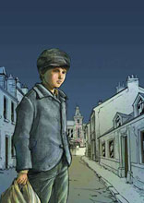
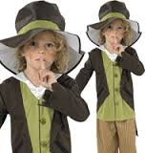
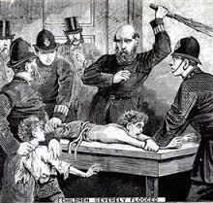
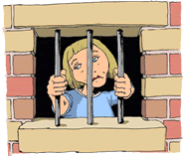
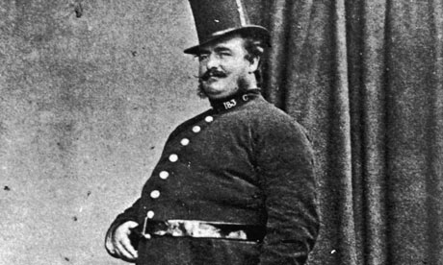
THE WORKING CLASS CHILDREN
In the towns and cities such as a London, where there was severe crowding, there was a big issue with children stealing from shops and the wealthy Middle-class. The Middle-class blamed Working-class children, who were poor and wanted them to be disciplined.
The police would either Punish the child severely, send them to a adult prison or send them to another country as punishment. They believed children were just small adults and there should be no difference in the way they are punished.
1 min

Slide 6
Learning objective: To be able to understand how children in Victorian Britain would be punished for crimes.
MAIN ACTIVITY
Victorian investigation
ALL students will be able to DESCRIBE how children were punished in Victorian Britain.
MOST students will able to EXPLAIN whether the Victorian punishments were fair.
SOME students will be able to INVESTIGATE the meanings of key words from this period.
.
You each have four different young Victorians in trouble with the law from the 19th century.
1.Answer the questions on your worksheet
2.Do you think their punishments was fair?
3. Extension work- complete the word search and match the words to their definitions
5-7 mins

Slide 7
Learning objective: To be able to understand how children in Victorian Britain would be punished for crimes.
Plenary
Learning objective: To be able to understand how children in Victorian Britain would be punished for crimes.
ALL students will be able to DESCRIBE how children were punished in Victorian Britain.
MOST students will able to EXPLAIN whether the Victorian punishments were fair.
SOME students will be able to INVESTIGATE the meanings of key words from this period.
How was Harry punished?
Why did children go to adult prisons?
Give me a different way children would have been punished in the Victorian age?
Key question: Do we think the punishments were fair?
3-5 mins

